Slide 1

Deep Neural Network Module # 6: CNN
DNN Team
BITS Pilani WILP

Slide 2
The instructor is gratefully acknowledging the authors who made their course materials freely available online.
This deck is prepared by Seetha Parameswaran.
Deep Neural Network

Slide 3










Table of Contents
Computer Vision Tasks
Image Basics and Image Classification Challenges
Introduction to Convolutional Networks
CNN Components
CNN Architecture Design
Popular CNN Architectures
Transfer Learning
CNN Applications
Implementation Considerations
Summary
1
2
3
4
5
6
7
8
9
10
Deep Neural Network

Slide 4
Receptive Field: Definition
Definition
The receptive field of a neuron is the region in the input image that affects that neuron’s activation value.
Key Concepts:
⁾ Receptive field grows with network depth
⁾ Early layers: small receptive fields (local patterns)
⁾ Deep layers: large receptive fields (global context)
⁾ Determined by kernel size, stride, and pooling
Importance:
⁾ Small receptive field: Cannot capture large objects
⁾ Large receptive field: Better context understanding
⁾ Trade-off: Computational cost vs. context
Deep Neural Network
Notes:
“The receptive field of a neuron is the region in the input image that affects that neuron’s activation value.”
Receptive field means: How much of the image a neuron is able to see
Your eye also doesn’t see everything at once. You focus on a small area, then move
One neuron does NOT see the full image — it only sees a small patch
In early layers, neurons are short‑sighted. In deep layers, neurons become far‑sighted
Early layer → edges
Deep layer → objects + context
Deeper network = larger view of the image

Slide 5
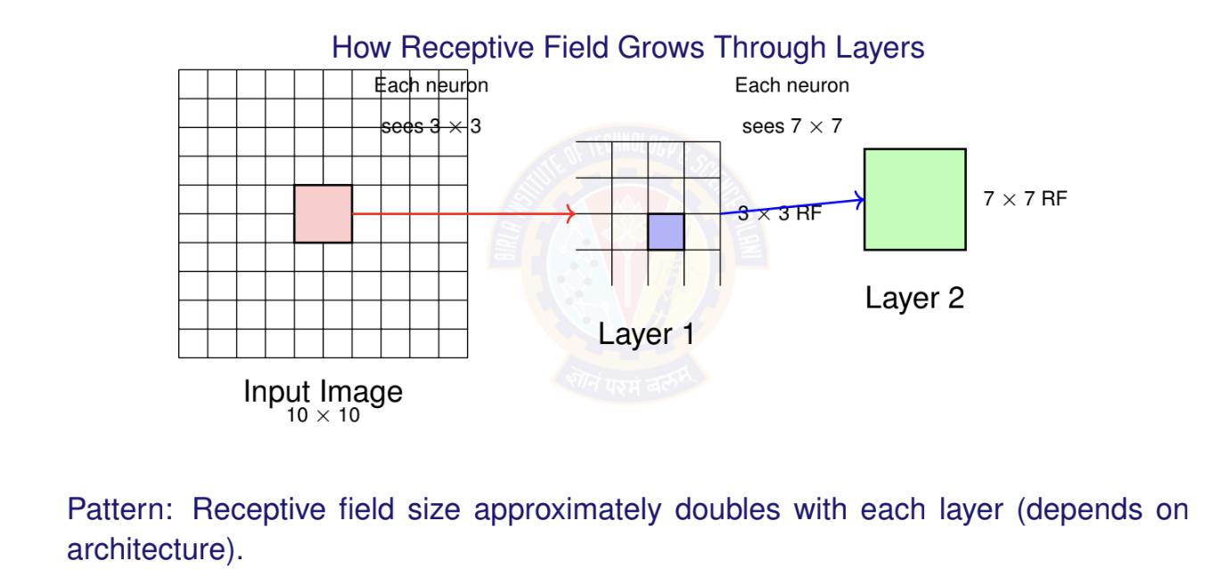
Receptive Field: Visual Example
Deep Neural Network
Notes:
This is the full image — but no neuron sees all of it.
In Layer 1, each neuron sees only a 3×3 part of the image.
This neuron has no idea what’s outside this box
Layer‑2 neuron does not look at pixels directly. It looks at Layer‑1 outputs
Because Layer‑1 already saw 3×3 areas, Layer‑2 indirectly sees a bigger area of the image
Neurons don’t see pixels — they see previous neurons
Receptive field approximately doubles with each layer.
Not magic, not fixed — it happens because layers stack information

Slide 6
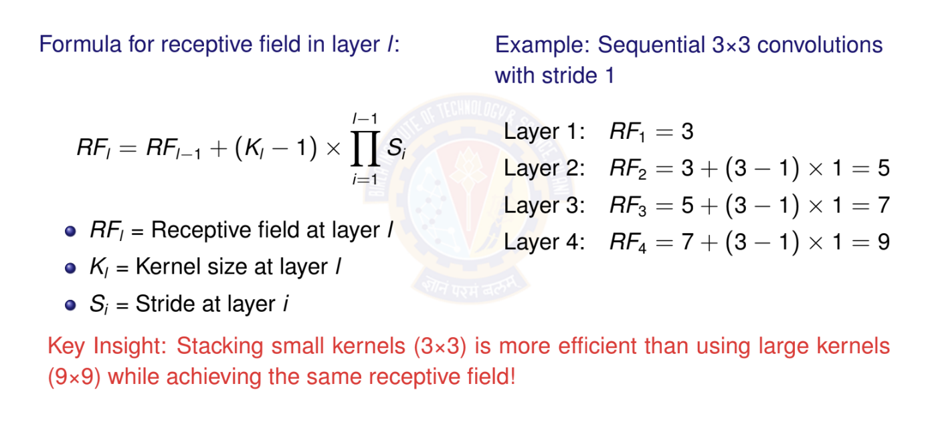
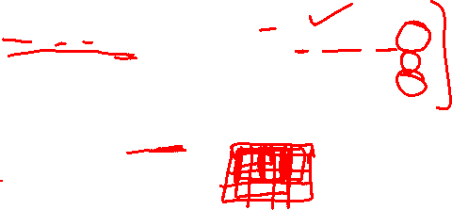
Receptive Field: Calculation
Deep Neural Network

Slide 7
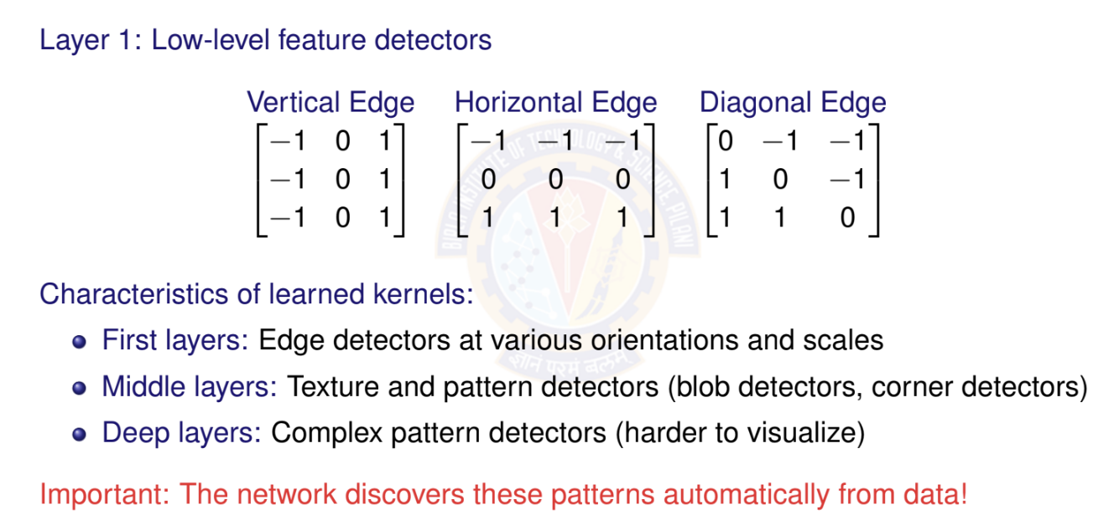
What Do Learned Kernels Look Like?
Deep Neural Network
Notes:
the network learns these filters automatically
These are not hardcoded. CNN discovers them from data
Dark vs light → contrast Change → edge
Edges are the alphabet of vision
Layer 1
Edges and lines — the ABCs of images
Middle layers
“Textures, corners, blobs”
Deep layers
“Faces, wheels, eyes, logos (hard to visualize)”
Humans DO NOT tell CNN what an edge is.” “CNN figures it out by itself.”

Slide 8
Padding
Why Padding?
Without padding: Output size = Input size - Kernel size + 1 Information at borders gets less attention
Deep networks would shrink feature maps rapidly
Types of Padding
Valid Padding: No padding (output smaller than input) Same Padding: Pad to keep output size = input size Full Padding: Maximum padding
Same Padding Calculation
For kernel size k and stride s = 1: Padding = (k — 1)/2
Deep Neural Network

Slide 9
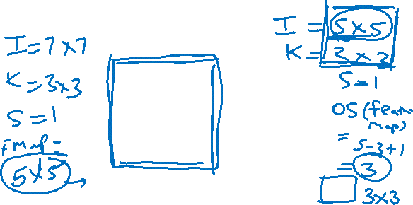
Convolution with Padding
Input Image with padding 8 × 8
0 | 0 | 0 | 0 | 0 | 0 | 0 | 0
0 | 1 | 0 | 0 | 0 | 0 | 1 | 0
0 | 0 | 1 | 0 | 0 | 1 | 0 | 0
0 | 0 | 0 | 1 | 1 | 0 | 0 | 0
0 | 1 | 0 | 0 | 0 | 1 | 0 | 0
0 | 0 | 1 | 0 | 0 | 1 | 0 | 0
0 | 0 | 0 | 1 | 0 | 1 | 0 | 0
0 | 0 | 0 | 0 | 0 | 0 | 0 | 0
Filter1
*
1 | -1 | -1
-1 | 1 | -1
-1 | -1 | 1
Deep Neural Network

Slide 10
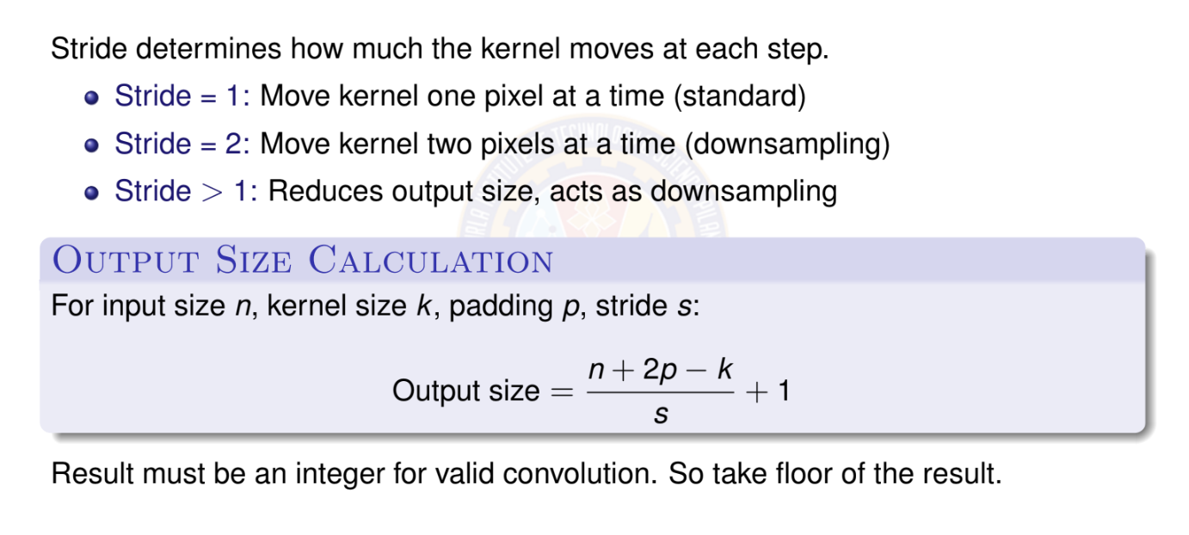
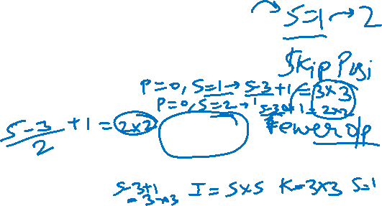
Stride
Deep Neural Network

Slide 11
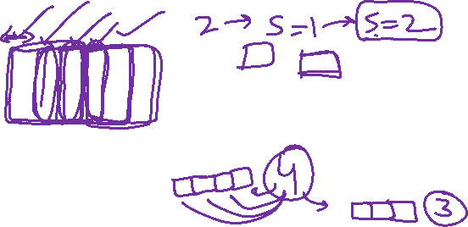
Convolution Operation with Stride
stride s = 3
1 | 0 | 0 | 0 | 0 | 1
0 | 1 | 0 | 0 | 1 | 0
0 | 0 | 1 | 1 | 0 | 0
1 | 0 | 0 | 0 | 1 | 0
0 | 1 | 0 | 0 | 1 | 0
0 | 0 | 1 | 0 | 1 | 0
1 | -1 | -1
-1 | 1 | -1
-1 | -1 | 1
3 -1
3 -1
Feature Map 2x2
Filter1
Input Image 6 × 6
Deep Neural Network

Slide 12
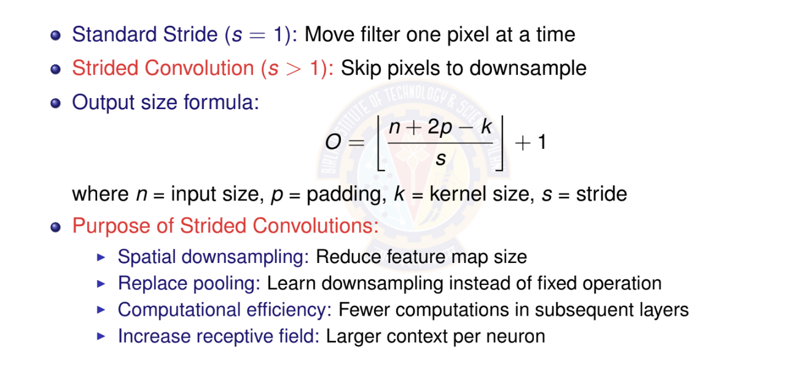
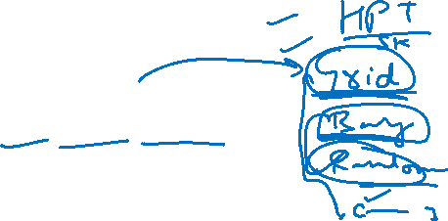
Strided Convolution
Deep Neural Network
61 / 153

Slide 13
Strided Convolution: Example
Stride = 2 Example:
31 | 32 | 33 | 34 | 35 | 36
25 | 26 | 27 | 28 | 29 | 30
19 | 20 | 21 | 22 | 23 | 24
13 | 14 | 15 | 16 | 17 | 18
7 | 8 | 9 | 10 | 11 | 12
1 | 2 | 3 | 4 | 5 | 6
1 | 2
3 | 4
Input: 6 × 6
3 × 3 kernel
Output: 2 × 2 (stride=2)
With stride = 2: Output size = ⁶⁻³ + 1 = 2
2
Trade-off: Lose spatial resolution but gain computational efficiency
Deep Neural Network

Slide 14
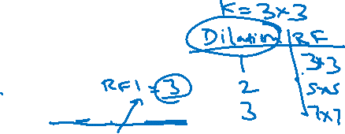
Dilated (Atrous) Convolution
Definition
Dilated convolution (also called atrous convolution) inserts spaces (holes) between kernel elements to increase receptive field without increasing parameters.
Dilation rate r : Number of pixels between kernel elements
r = 1: Standard convolution (no dilation)
r = 2: One pixel gap between kernel elements
r = 3: Two pixel gaps between elements
Effective receptive field:
k_{eff} = k + (k — 1)(r — 1)
where k = kernel size, r = dilation rate
Example: 3 × 3 kernel with r = 2 effective 5 × 5 receptive field
Deep Neural Network

Slide 15
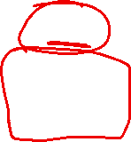
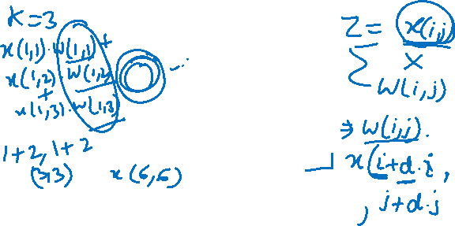
Dilated Convolution: Visual Example
Standard vs. Dilated Convolution
Standard (r = 1)
Dilated (r = 2)
Receptive field: 3 × 3
Receptive field: 5 × 5
Key Advantage: Same number of parameters (9), but larger receptive field!
Deep Neural Network

Slide 17
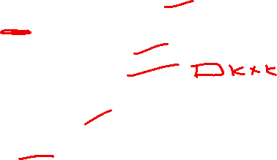
Dilated Convolution: Applications and Benefits
When to Use Dilated Convolutions:
⁾ Semantic segmentation: Need large receptive field while maintaining resolution
⁾ Dense prediction tasks: Object detection, depth estimation
⁾ Audio processing: WaveNet uses dilated convolutions for sequence modeling
Benefits:
1
Larger receptive field without pooling or striding Preserve spatial resolution (no downsampling) Same parameter count as standard convolution Multi-scale context by using different dilation rates
2
3
4
Trade-offs:
⁾ May lose fine-grained local information
⁾ Gridding artifacts possible (mitigated with varying dilation rates)
⁾ Slightly more memory usage during forward pass
Deep Neural Network

Slide 18
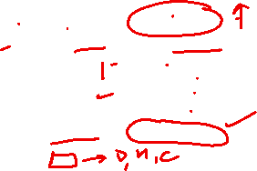
Strided vs. Dilated Convolution: Comparison
Property | Strided Conv | Dilated Conv
Output size Receptive field Parameters | Reduced Increased Same | Same as input Increased Same
Downsampling Resolution loss Typical use | Yes Yes Classification | No No Segmentation
Summary:
Strided convolution: Reduce spatial dimensions, typically for classification
Dilated convolution: Increase receptive field while maintaining resolution, for dense predictions
Both are alternatives to pooling for different purposes
Deep Neural Network

Slide 19
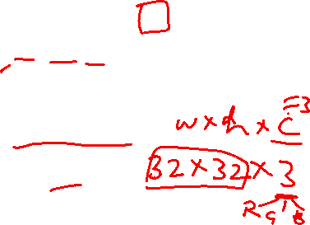
Multiple Channels: Introduction
Reality Check
Real images have multiple channels:
RGB images: 3 channels (Red, Green, Blue) Grayscale: 1 channel
Feature maps in CNNs: Typically 64, 128, 256, or 512 channels
Questions:
How does convolution work with multi-channel inputs? How do we get multi-channel outputs?
How many parameters do we need?
1
2
3
Deep Neural Network

Slide 20
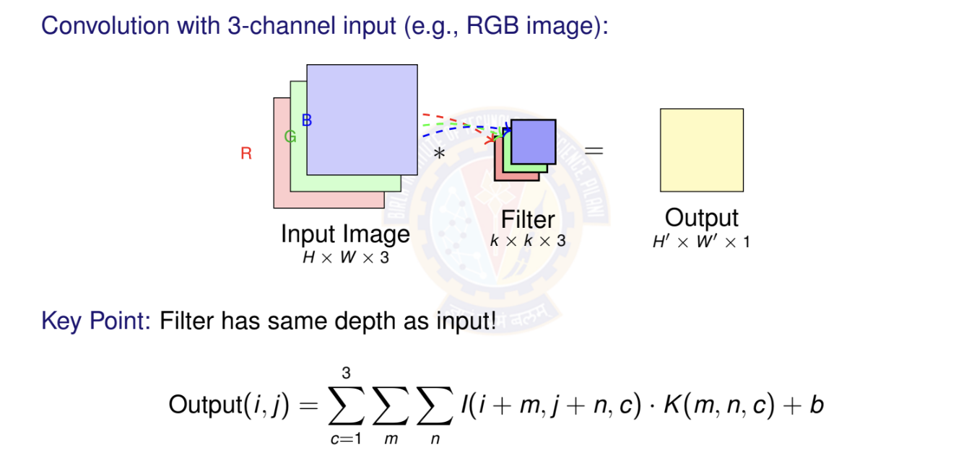
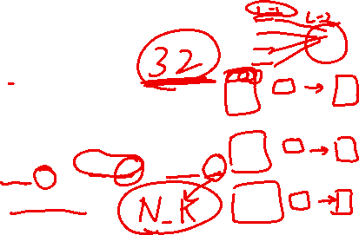
Multi-Channel Input: Single Filter
Deep Neural Network

Slide 21
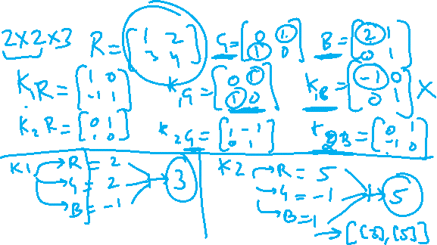

Slide 22
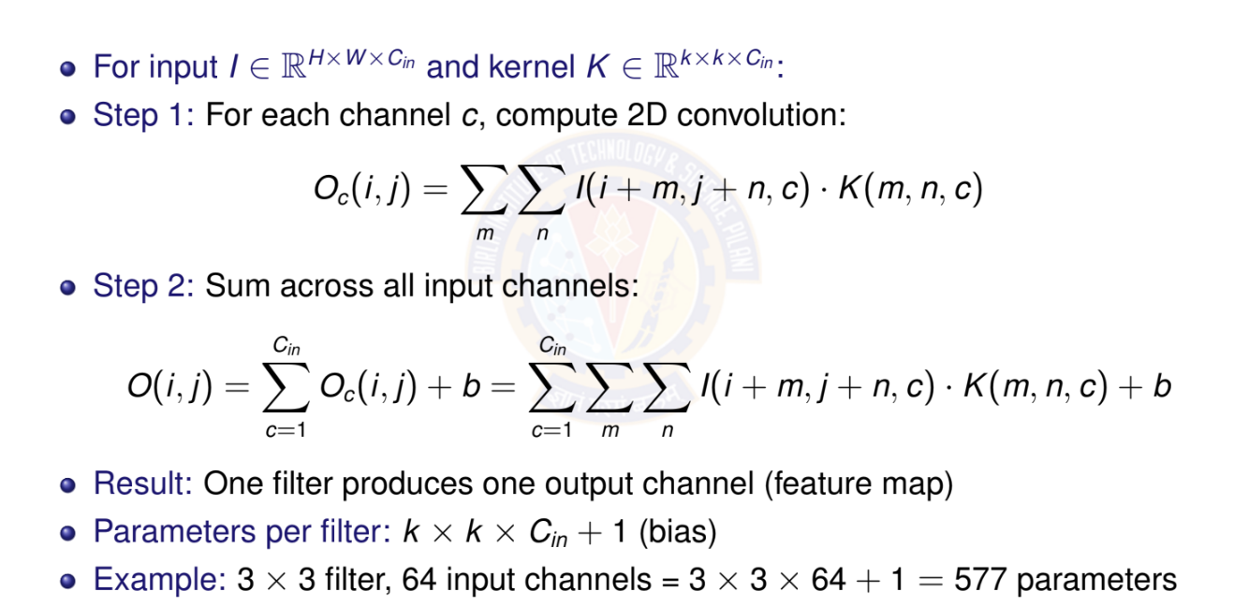
Multi-Channel Convolution: Mathematical
Deep Neural Network

Slide 23
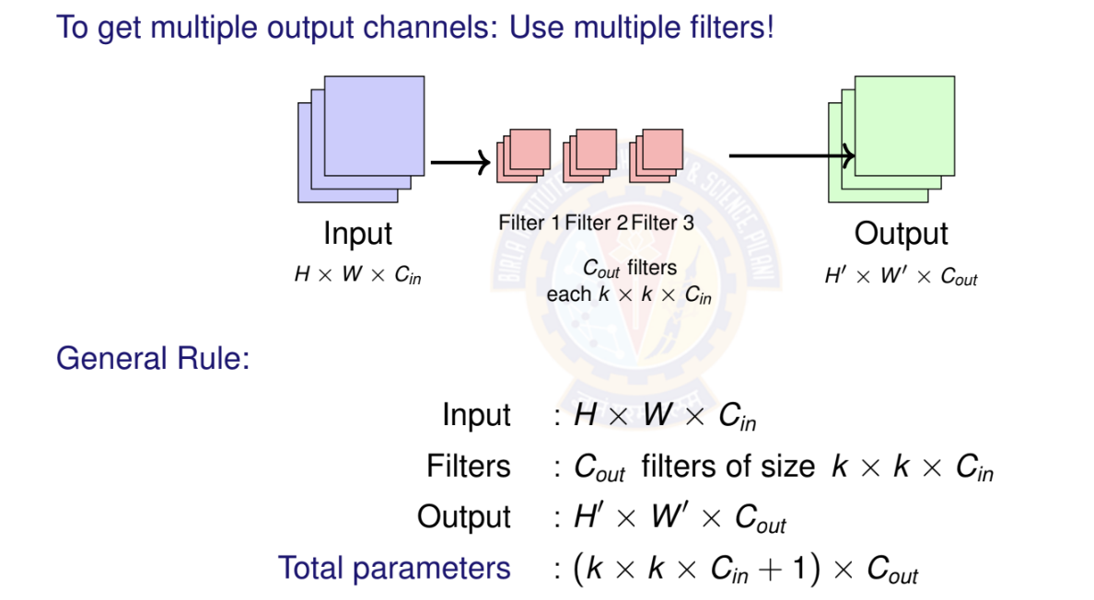
Multi-Channel Input and Output

Slide 24
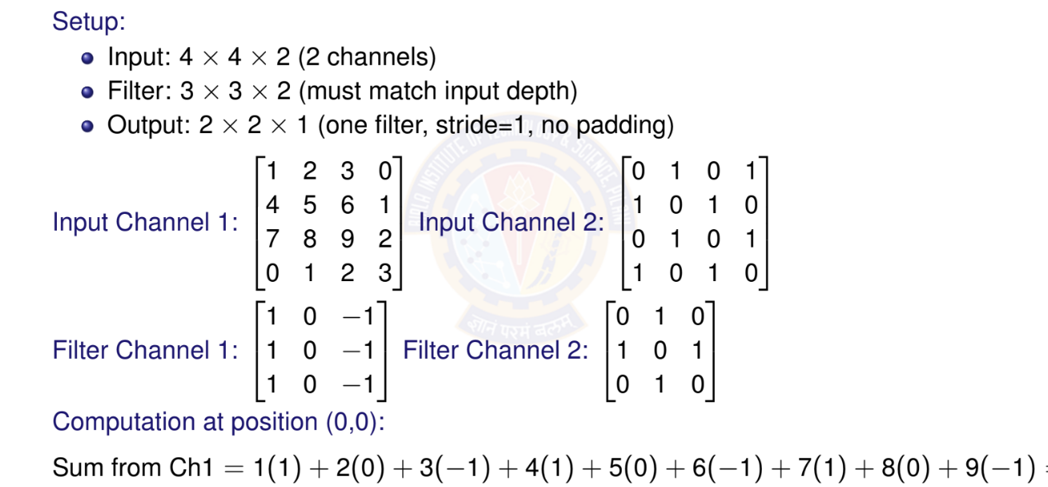
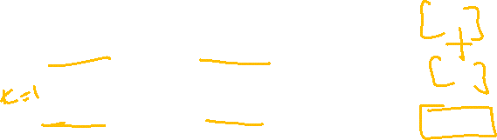
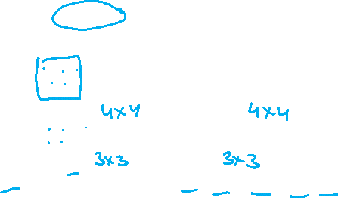
Multi-Channel Example: Numerical

Slide 25
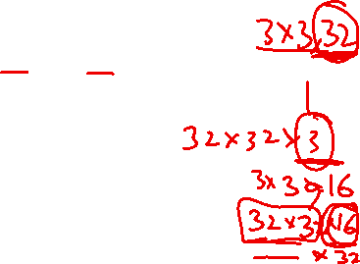
Channel Evolution in Deep CNNs
Typical pattern: Increase channels while decreasing spatial dimensions
224 × 224
×3
112 × 112
56 × 56
28 × 28
14 × 14
×64
×128
×256
×512
Input
Conv1 Conv2 Conv3 Conv4
Why this pattern?
Early layers: High resolution, few channels (local patterns)
Deep layers: Low resolution, many channels (semantic features) Maintains roughly constant computational cost per layer
Total information capacity: H × W × C approximately constant
Deep Neural Network
72 / 153

Slide 26
Multi-Channel Convolution: Key Takeaway
Input channels: Filter depth = Input depth (must match)
Output channels: Number of filters = Number of output channels Parameters: (k × k × C_{in} + 1) × C_{out}
Computation: Each filter operates on all input channels simultaneously
Important Relationships:
One filter → One output channel (feature map)
More filters → More output channels Network can learn more diverse features
Typical progression: Channels increase with depth (3 64 128 256
512)
Memory consideration: Deep networks trade spatial resolution for channel depth.
Memory ∝ H × W × C
1
2
3
4
Deep Neural Network

Slide 27
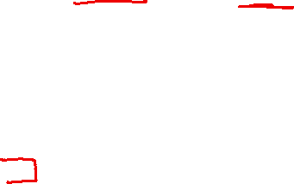
Pooling Operations
What Pooling Layers Do
Spatial Downsampling: Reduce height and width dimensions but preserve channel depth.
Translation Invariance: Make features less sensitive to small shifts.
Computational Efficiency: Reduce number of computations in subsequent layers.
Overfitting Reduction: Act as a form of regularization.
Pooling layers are parameter-free but still important for network performance Global Average Pooling (GAP) is used to replace fully connected layers.
Two types
1
Max pooling Average pooling
2
Deep Neural Network

Slide 28
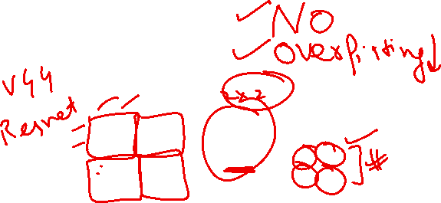
Max Pooling
Takes maximum value in each region Most common pooling operation Preserves strongest activations
output = max(inputs in window)
Input 4 × 4
Output 2 × 2
2 | 4 | 7 | 4
6 | 6 | 9 | 8
3 | 4 | 8 | 3
7 | 5 | 3 | 6
Max pooling
k = 2
s = 2
→
→
6 | 9
7 | 8
Deep Neural Network

Slide 29
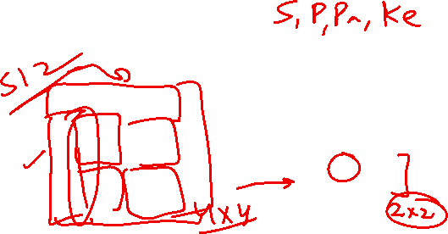
Average Pooling
Takes average of values in region Smoother downsampling
Used in final layers sometimes
output = ¹ (inputs in window)
_{k} 2
Input 4 × 4
Output 2 × 2
2 | 4 | 7 | 4
6 | 6 | 9 | 8
3 | 4 | 8 | 3
7 | 5 | 3 | 6
Average pooling
k = 2
s = 2
→
→
4.5 | 7
4.75 | 5
Deep Neural Network

Slide 30
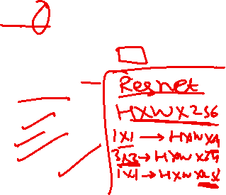
1 1 Convolution: Introduction
Definition
A 1×1 convolution uses a kernel of size 1 × 1 × C_{in} to perform a weighted sum across channels at each spatial location.
At First Glance:
Seems pointless: No spatial information, just a single pixel! But actually very powerful: ”Network in Network”
What it does:
Combines information across channels Acts as a learned linear combination Does NOT look at neighboring pixels
Applied independently at each spatial position
Deep Neural Network

Slide 31
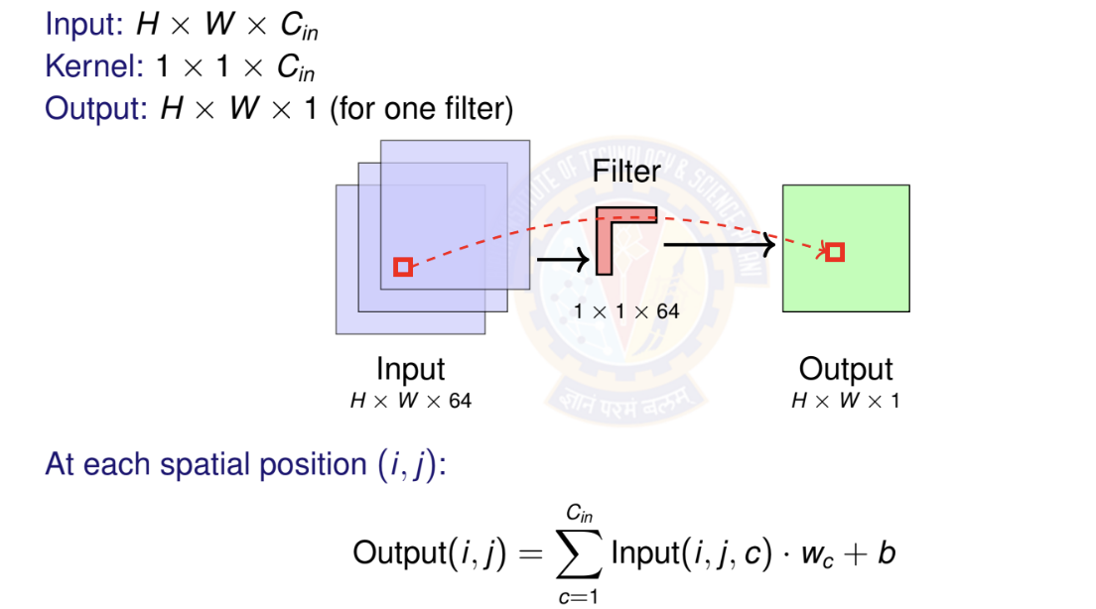
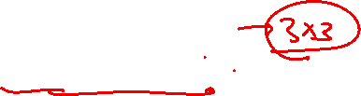
1 1 Convolution: How It Works
Deep Neural Network

Slide 32
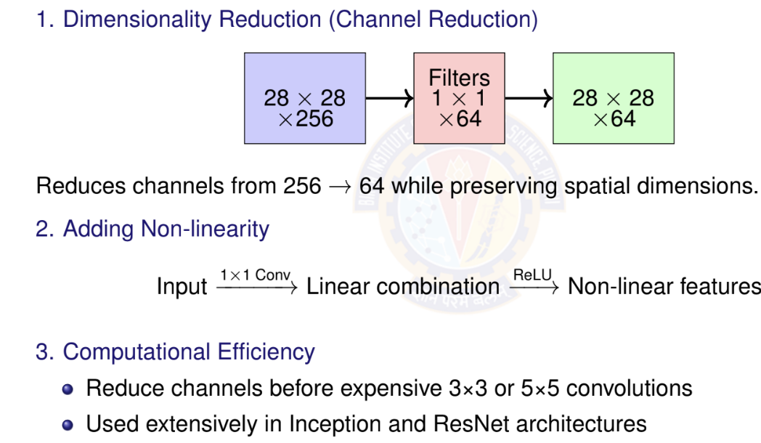
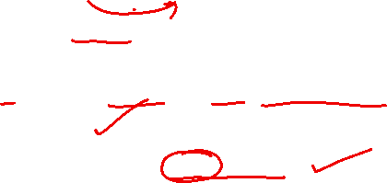
1 x 1 Convolution: Key Applications
Deep Neural Network

Slide 33
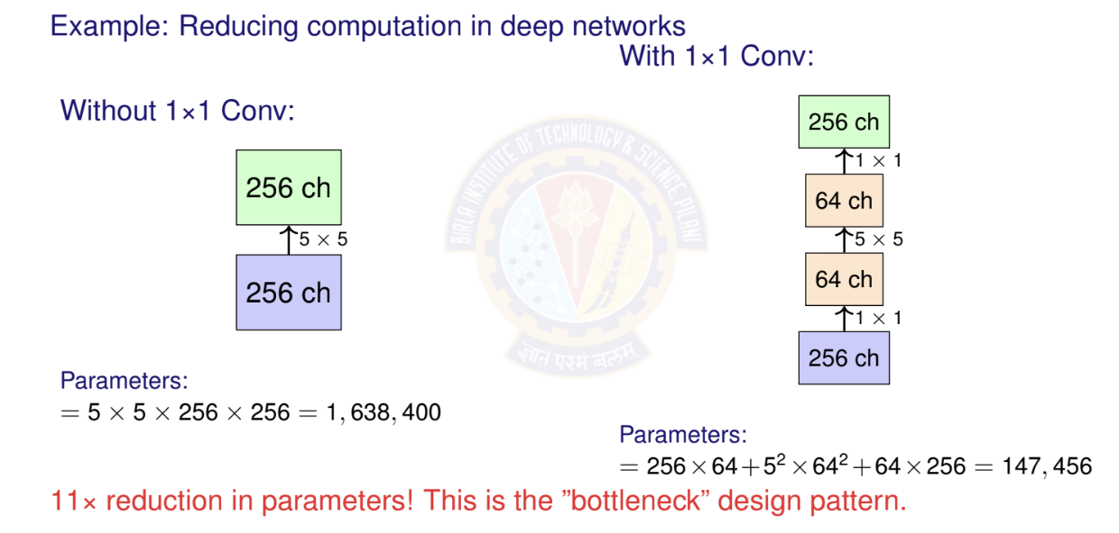
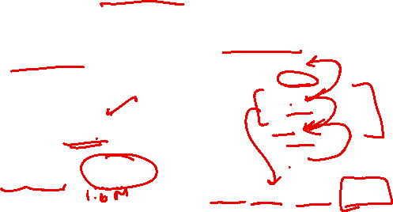
1 x 1 Convolution: Bottleneck Architecture
Deep Neural Network

Slide 34
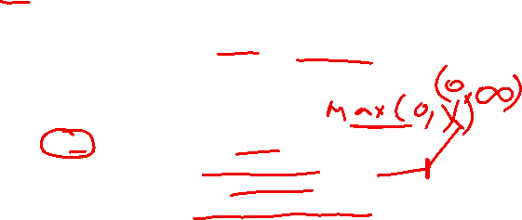
ReLU Activation Function
Definition
ReLU (Rectified Linear Unit) is a simple and powerful activation function that outputs the input directly if positive, otherwise outputs zero.
Key Properties
Non-linear: Enables learning complex patterns Sparse: Many outputs are exactly zero Computationally efficient: Simple max operation Non-saturating: No upper bound on positive values
Usage in CNNs ReLU is the default choice for activation functions in CNNs and is typically applied after each convolutional layer:
Conv Layer Output → ReLU → Next Layer
Deep Neural Network

Slide 35
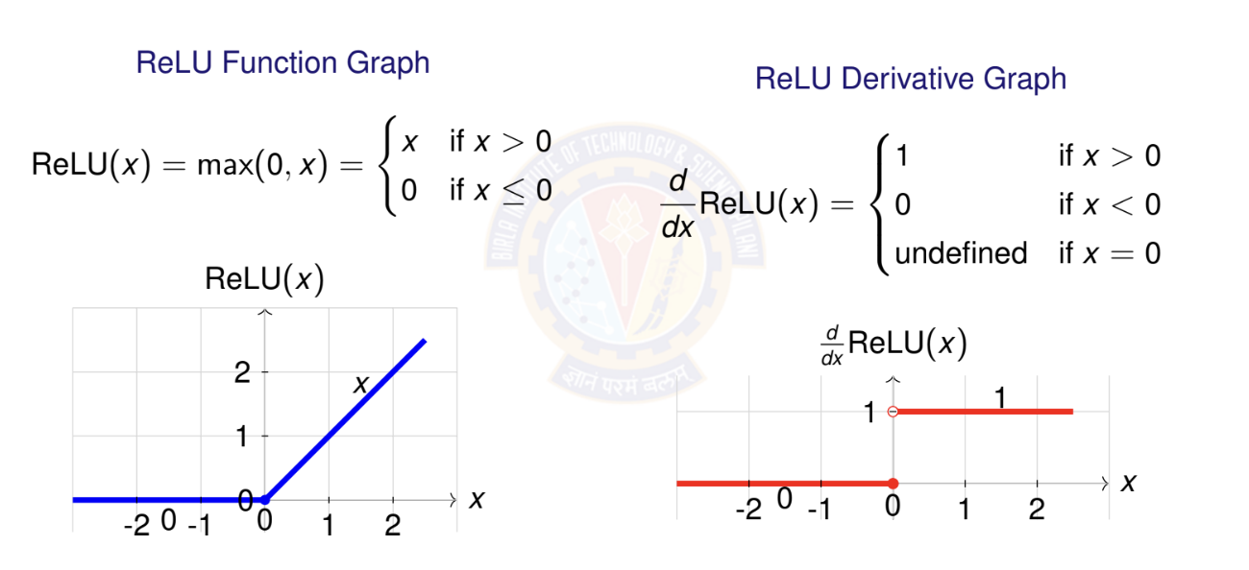
ReLU Activation Function
Deep Neural Network

Slide 36
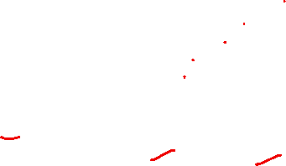
ReLU Activation Function
Advantages of ReLU
Solves Vanishing Gradient Problem: Gradient is either 0 or 1 (no saturation for positive values)
Computational Efficiency: No expensive operations (exp, log, etc.) Sparse Representation: Naturally produces sparse networks Biological Plausibility: Similar to neuron firing patterns
Scale Invariant: ReLU(αx ) = α · ReLU(x ) for α > 0
Disadvantages of ReLU
Dying ReLU Problem: Neurons can become permanently inactive (output always 0)
Not Zero-Centered: Output is always non-negative
Non-Differentiable at Zero: Can cause issues in some optimization scenarios
Deep Neural Network

Slide 37
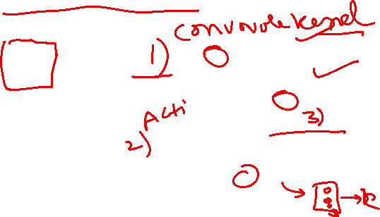
Convolution + ReLu + Max Pooling
Input Image 6 × 6
Convolve, s=1
1 | 0 | 0 | 0 | 0 | 1
0 | 1 | 0 | 0 | 1 | 0
0 | 0 | 1 | 1 | 0 | 0
1 | 0 | 0 | 0 | 1 | 0
0 | 1 | 0 | 0 | 1 | 0
0 | 0 | 1 | 0 | 1 | 0
-1 | -1 | -1 | -1
-1 | -1 | -2 | -1
-1 | -1 | -2 | 1
-1 | 0 | -4 | 3
Apply ReLU
Maxpool k=2, s=2
0 | 0 | 0 | 0
0 | 0 | 0 | 0
0 | 0 | 0 | 1
0 | 0 | 0 | 3
Filter
-1 | 1 | -1
-1 | 1 | -1
-1 | 1 | -1
0 | 0
0 | 3
Deep Neural Network

Slide 38
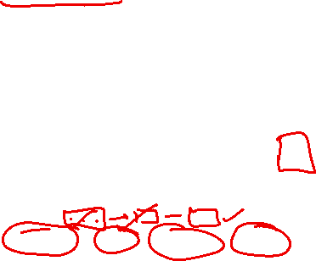
Fully Connected (Dense) Layer
Definition
A Fully Connected (FC) Layer or Dense Layer is a layer where every neuron is connected to every neuron in the previous layer, performing a linear transformation followed by an activation function.
Role in CNN Architecture
Feature Flattening: Convert spatial features to vector:
(H × W × C) → (H · W · C)
Classification Head: Map features to class scores Dimensionality Control: Adjust feature vector size
Non-linear Mapping: Learn complex decision boundaries Typical CNN Flow:
Conv Layers → Flatten → FC Layer(s) → Output
Deep Neural Network

Slide 39

Fully Connected (Dense) Layer
y = f (Wx + b)
x ∈ R^{n} : Input Vector
W ∈ R^{m×n} : Weight matrix
b ∈ R^{m} : Bias vector f (·): Activation function y ∈ R^{m} : Output vector
Parameter Count
Weights: n × m parameters Biases: m parameters
Total: n × m + m = m(n + 1)
FC Layer Architecture
^{w}11
b₃
x
y₃
y₂
4
x₃ x₂ x₁
W ^{b}
2
b
y
1
1
w
Input Layer
³¹ Output Layer
(n = 4)
(m = 3)
Deep Neural Network

Slide 40
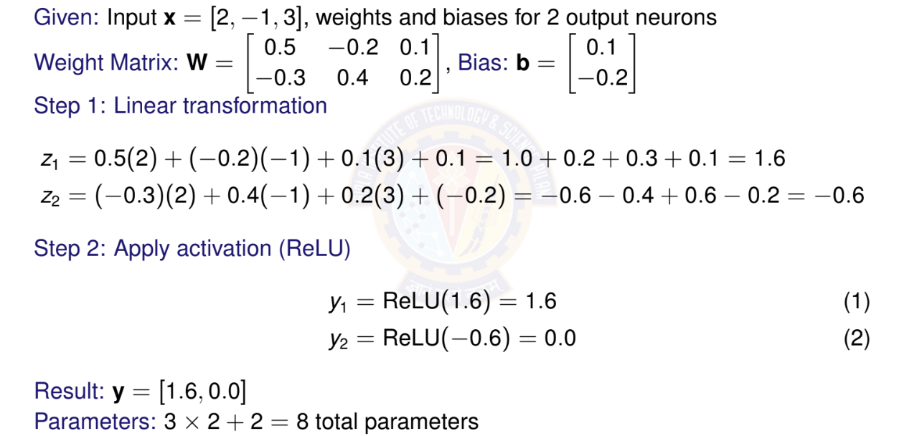
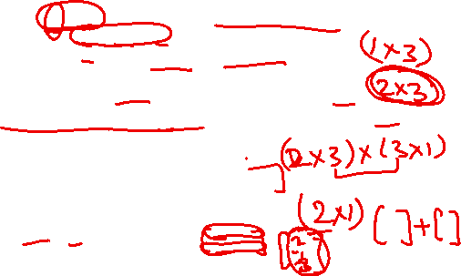
FC Layer - Numerical Example
Deep Neural Network

Slide 41
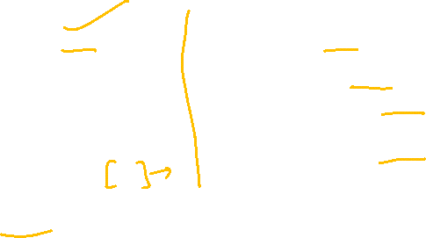
FC - Advantages and Disadvantages
Advantages:
Universal Approximation: Can learn any function
Flexible Output Size: Any input
any output dimension
Non-linear Transformations: Complex mappings
Feature Integration: Combines all spatial information
Modern Alternatives
Disadvantages:
Parameter Heavy: Many parameters
→ overfitting risk
Spatial Information Loss: No spatial structure preservation
Fixed Input Size: Requires consistent input dimensions
Computational Cost: Matrix multiplication overhead
Global Average Pooling (GAP): Replace FC with average pooling
1×1 Convolutions: Maintain spatial structure while reducing channels
Deep Neural Network

Slide 42

Softmax Activation Function
Definition
Softmax is an activation function that converts a vector of real numbers into a probability distribution, commonly used in the output layer for multi-class classification.
Usage in CNNs Softmax is typically used in the final layer for multi-class classifica- tion:
Final Conv/FC Layer → Softmax → Class Probabilities
Deep Neural Network

Slide 43
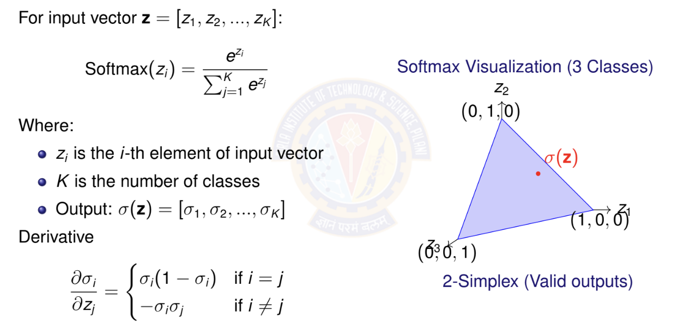
Softmax Activation Function
Deep Neural Network

Slide 44
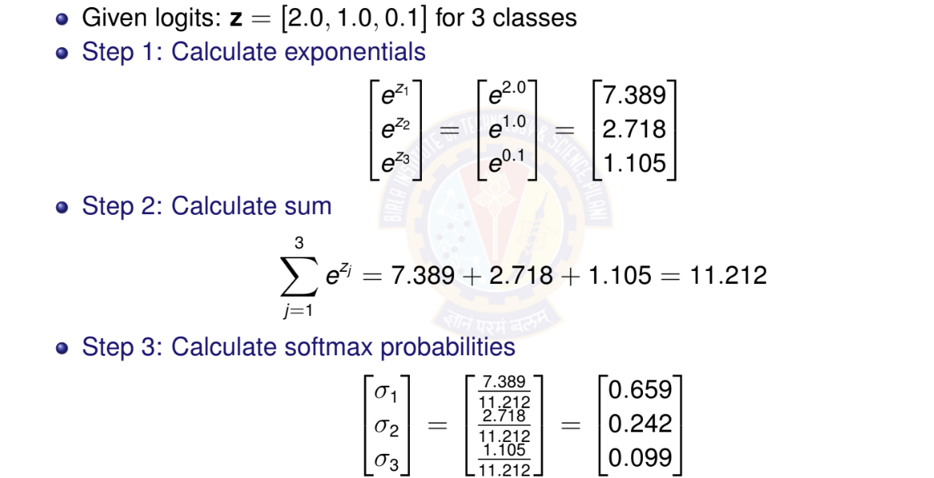
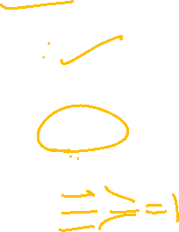
Softmax - Numerical Example
Deep Neural Network

Slide 45


Table of Contents
Computer Vision Tasks
Image Basics and Image Classification Challenges
Introduction to Convolutional Networks
CNN Components
CNN Architecture Design
Popular CNN Architectures
Transfer Learning
CNN Applications
Implementation Considerations
Summary
1
2
3
4
5
6
7
8
9
10
Deep Neural Network

Slide 46
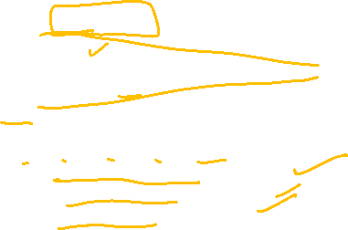
Typical CNN Architecture
32×32×3
28×28×6
14×14×6
10×10×16
5×5×16
120
10
Input
Conv1 Pool1 Conv2 Pool2 FC
Output
Pattern: CONV → POOL →CONV →POOL →FC →OUTPUT
Early layers: Detect low-level features (edges, corners) Middle layers: Combine features (shapes, textures) Later layers: High-level concepts (objects, faces) Spatial size decreases, depth increases
Deep Neural Network
93 / 153

Slide 47
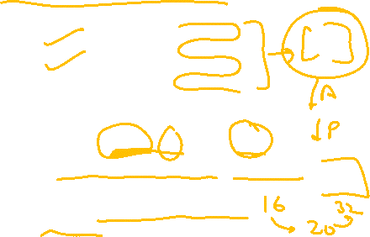
Number of Parameters in Convolutional Layer
For a convolutional layer with: Kernel size: K × K
Input channels: C_{in}
Output channels (number of filters): C_{out}
Bias: Yes/No, Where bias = 1 if bias is used, 0 otherwise
Total Parameters = (K × K × C_{in} + bias) × C_{out}
Parameters are independent of input spatial dimensions (height, width) Each filter has the same depth as input channels
Number of parameters grows quadratically with kernel size Adding more filters increases parameters linearly
Deep Neural Network

Slide 48
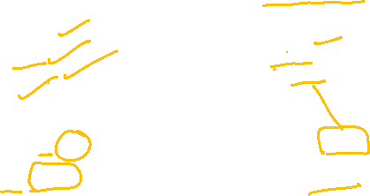
Number of Parameters in Convolutional Layer
Example 1: First Convolutional Layer
⁾ Input: RGB image
(224 × 224 × 3)
⁾ Kernel size: 5 × 5
⁾ Number of filters: 64
⁾ Bias: Yes
Calculation:
⁾ Parameters per filter
= 5 × 5 × 3 + 1 = 76
⁾ Total parameters
= 76 × 64 = 4, 864
Example 2: Deeper Convolutional Layer
⁾ Input: Feature map
(56 × 56 × 128)
⁾ Kernel size: 3 × 3
⁾ Number of filters: 256
⁾ Bias: Yes
Calculation:
⁾ Parameters per filter
= 3 × 3 × 128 + 1 = 1,153
⁾ Total parameters
= 1, 153 × 256 = 295,168
Deep Neural Network

Slide 49

Number of Parameters in Pooling Layers
Key Insight
Pooling layers have ZERO learnable parameters!
Why Zero Parameters?
Pooling operations are fixed mathematical functions: max or average
No weights or biases to learn
Only hyperparameters: pool size k and stride s
Deep Neural Network

Slide 50

Number of Parameters in Pooling Layers
Max Pooling Example
Input: (56 × 56 × 128)
Pool size: 2 × 2
Stride: 2
Output: (28 × 28 × 128)
Parameters: 0
Average Pooling Example Input: (56 × 56 × 128)
Pool size: 2 × 2
Stride: 2
Output: (28 × 28 × 128)
Parameters: 0
Deep Neural Network

Slide 51

References
Zhang, A., Lipton, Z. C., Li, M., & Smola, A. J. (2023). Dive into deep learning. Cambridge University Press. Chapters 6 and 7.
Goodfellow, I., Bengio, Y., Courville, A. (2016). Deep Learning. MIT Press. LeCun, Y., Bottou, L., Bengio, Y., & Haffner, P. (1998). Gradient-based learning applied to document recognition. Proceedings of the IEEE, 86(11), 2278-2324.
Krizhevsky, A., Sutskever, I., & Hinton, G. E. (2012). ImageNet classification with deep convolutional neural networks. Advances in NIPS.
Simonyan, K., & Zisserman, A. (2014). Very deep convolutional networks for large-scale image recognition. arXiv preprint arXiv:1409.1556.
Szegedy, C., et al. (2015). Going deeper with convolutions. Proceedings of the IEEE CVPR.
He, K., Zhang, X., Ren, S., & Sun, J. (2016). Deep residual learning for image recognition. Proceedings of the IEEE CVPR.
Deep Neural Network

